Slide 1
Digital Portfolio
STUDENT NAME: Mohamed Rilvan
REGISTER NO AND NMID:24131090500121007 4189CB055FE53BF996345DB244EDBA90
DEPARTMENT: BCA
COLLEGE: COLLEGE/ UNIVERSITY : Thiruvalluvar Arts and Science College Kurinjipadi , Cuddalore

Slide 2
PROJECT TITLE
Supermarket Bill Counter

Slide 3


AGENDA
Problem Statement
Project Overview
End Users
Tools and Technologies
Portfolio design and Layout
Features and Functionality
Results and Screenshots
Conclusion
Github Link
3/21/2024 Annual Review

Slide 4

PROBLEM STATEMENT
In supermarkets, manual billing takes time and can lead to errors.
• Customers often face long queues due to slow billing.
• There is a need for a simple, fast, and error-free billing system.

Slide 5

PROJECT OVERVIEW
A web-based billing application created with HTML, CSS, and JavaScript.
• Users can add items with price and quantity.
• The system automatically calculates the grand total.
• Provides a simple, user-friendly interface.

Slide 6

WHO ARE THE END USERS?
Supermarket staff (cashiers)
• Small shop owners
• Students (for learning projects)

Slide 7

TOOLS AND TECHNIQUES
Frontend: HTML, CSS, JavaScript
• Editor: VS Code / Sublime / Notepad++
• Browser: Chrome, Edge, Firefox

Slide 8
POTFOLIO DESIGN AND LAYOUT
Input fields for item name, price, and quantity.
• Table to display items with totals.
• Grand total displayed at the bottom.
• Clean, minimal design for easy usage.
‹#›

Slide 9
FEATURES AND FUNCTIONALITY
Add multiple items dynamically.
• Automatic calculation of total price.
• Clear inputs after adding items.
• Grand total updates in real-time.

Slide 10
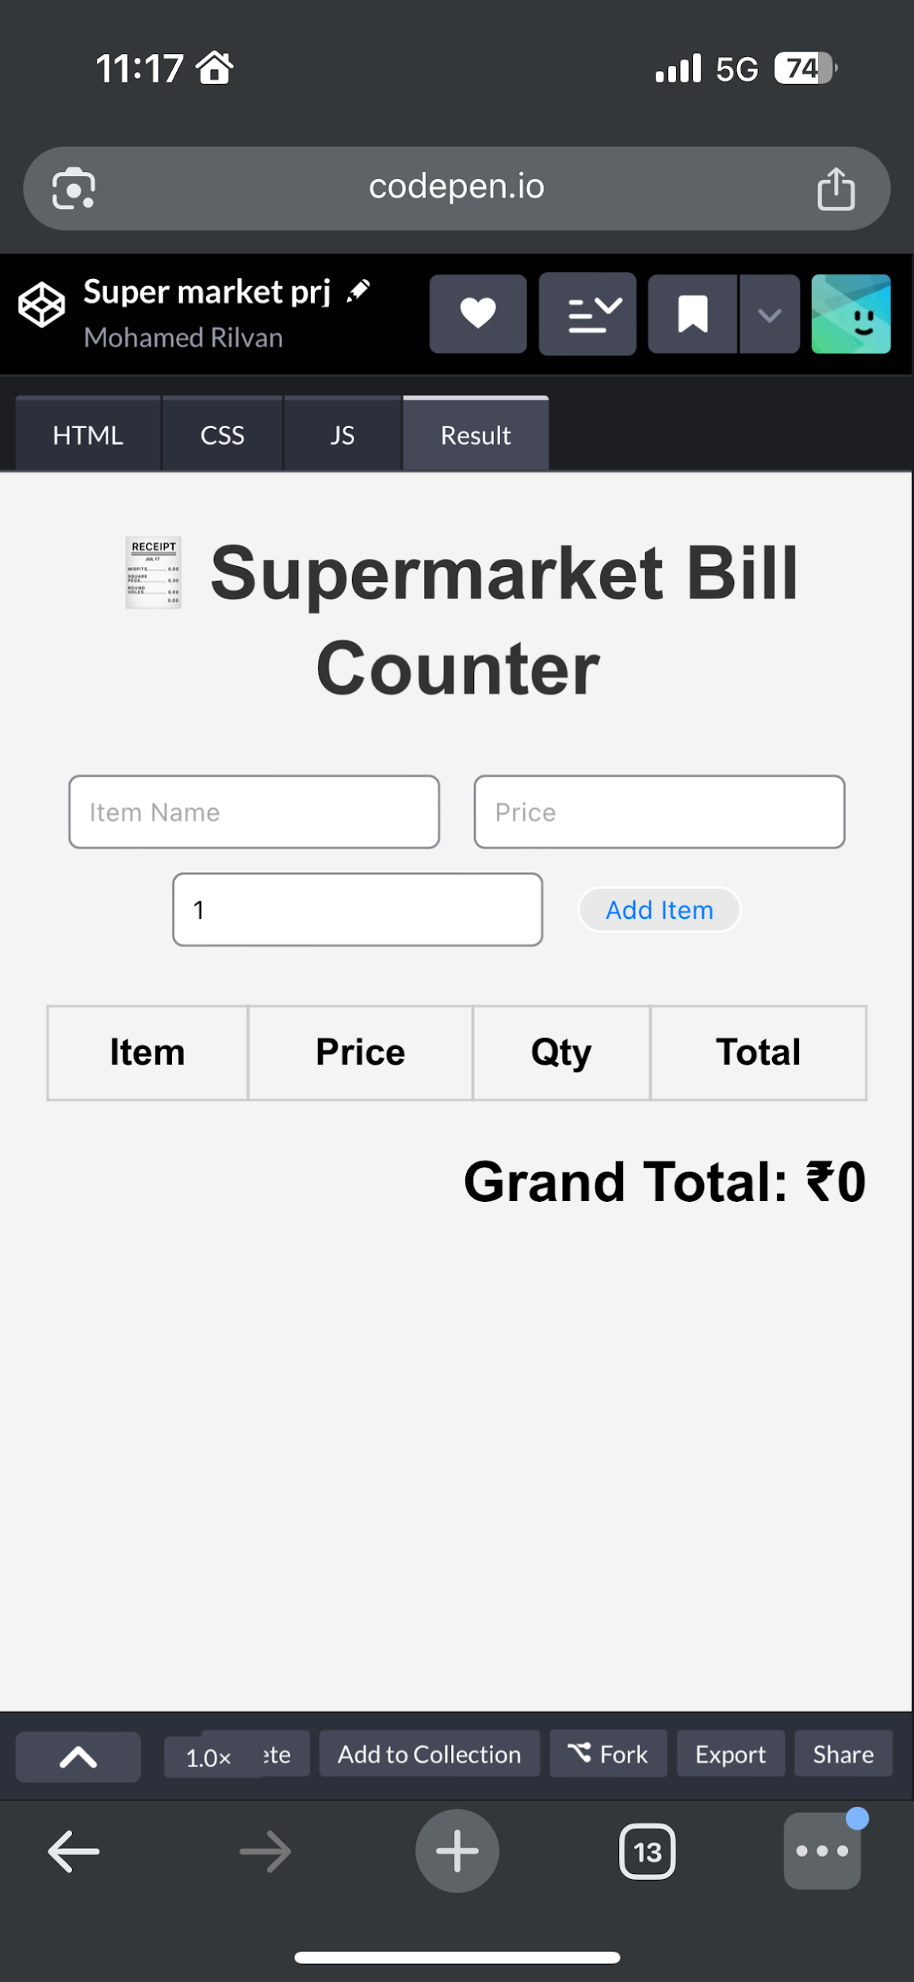

RESULTS AND SCREENSHOTS
3/21/2024 Annual Review
‹#›

Slide 11
CONCLUSION
The system reduces human error.
• Provides quick billing in a simple manner.
• Useful for supermarkets and small shops.
‹#›

